Slide 1
ANALYSIS of SALES DATA
2016 RETAIL STORE SALES DATA ANALYSIS (SOUTH REGION)
Meghana Suresha
Contact: meghanamegha0610@gmail.com

Slide 2

Data Source: Dataset : Superstore Sales Dataset(from kaggle) Period Covered : 2015 -2018 Region Analyzed : South Analysis Focus : Sales performance in 2016
Data Overview

Slide 3
The motivation behind this analysis is to examine sales data to uncover trends, identify underperforming regions and categories, and support data-driven decision-making for improving business performance.

Slide 4
Problem Statement Sales in the South region decreased in 2016.This analysis aims to determine the category responsible for the decline and identify the key drivers behind the reduced sales performance.
Quetions
What are the overall sales trends from 2015–2018?
Which region showed the highest decline in 2016?
Which category contributed most to the decline in the South region?
What are the possible reasons behind the drop in sales?

Slide 5
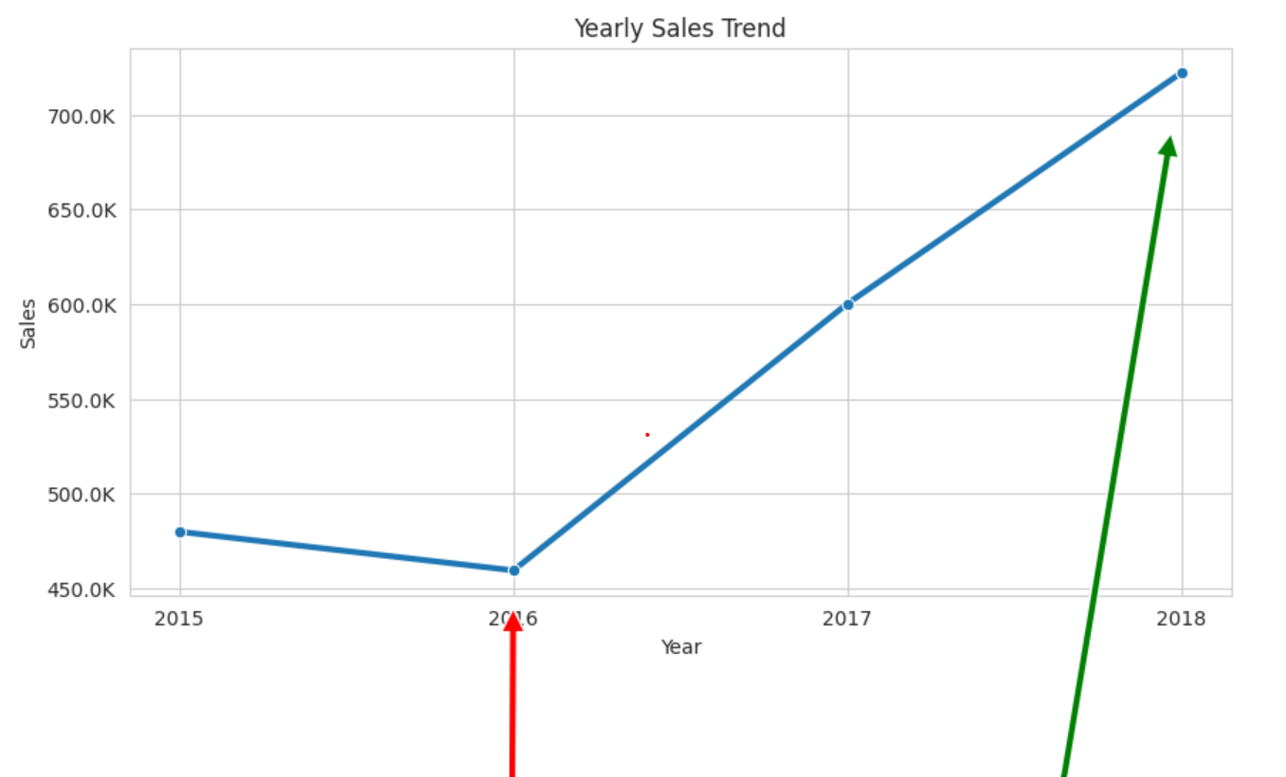
Yearly sales analysis
Observation:
Sales dropped from 2015 to 2016.
2016 recorded the lowest sales during the period.
Sales improved again after 2016, showing recovery and growth.

Slide 6
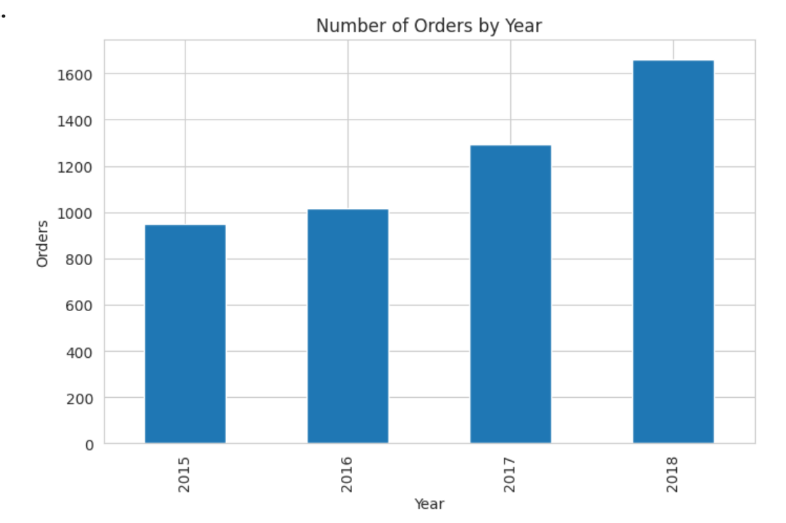
orders analysis
Observation:
Sales decresed in 2016.
Order did not decreased.
revenue per order may decreased.

Slide 7
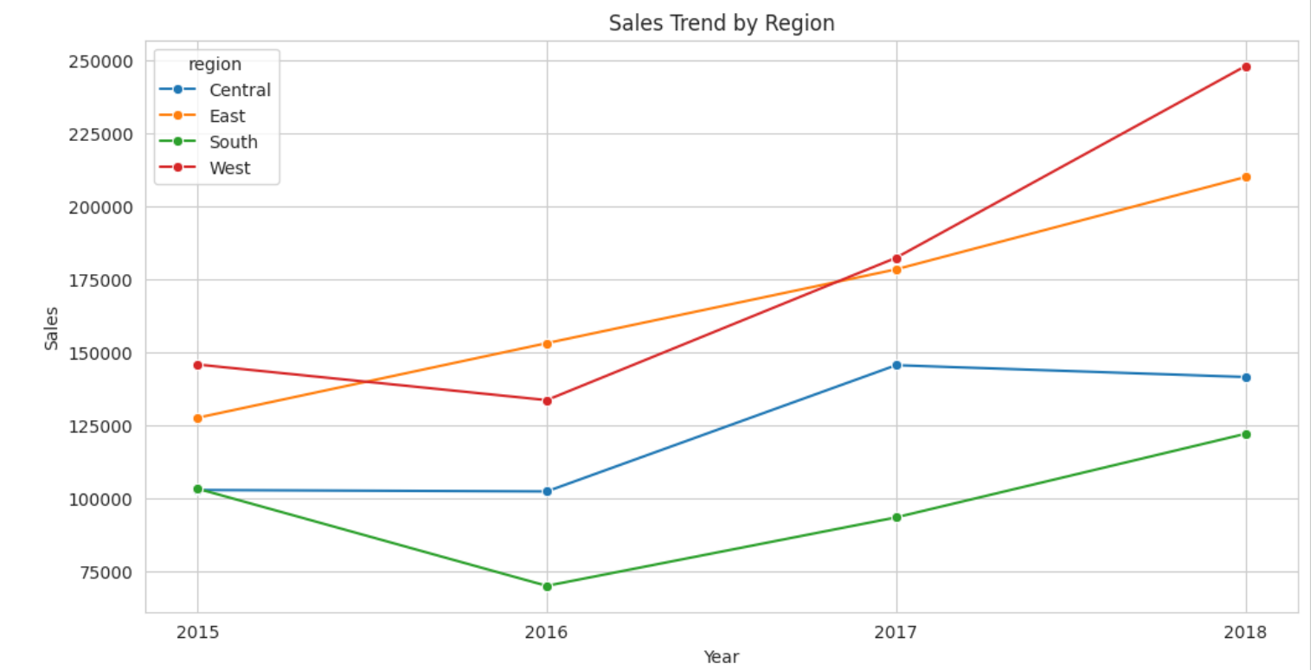
Yearly sales analysis
Observation:
Sales in the South region dropped in 2016.
The decline in the South region was a major factor behind the overall reduction in sales.
Other regions performed relatively better, indicating that the issue was specific to the South region.

Slide 8
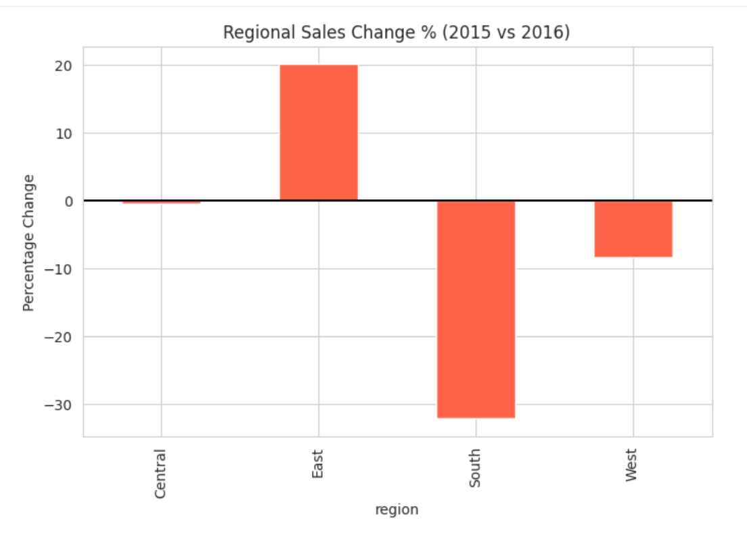
Regional sales analysis
Observation:
South region sales decreased by 33.21%.
This was the most significant decline among all regions.

Slide 9
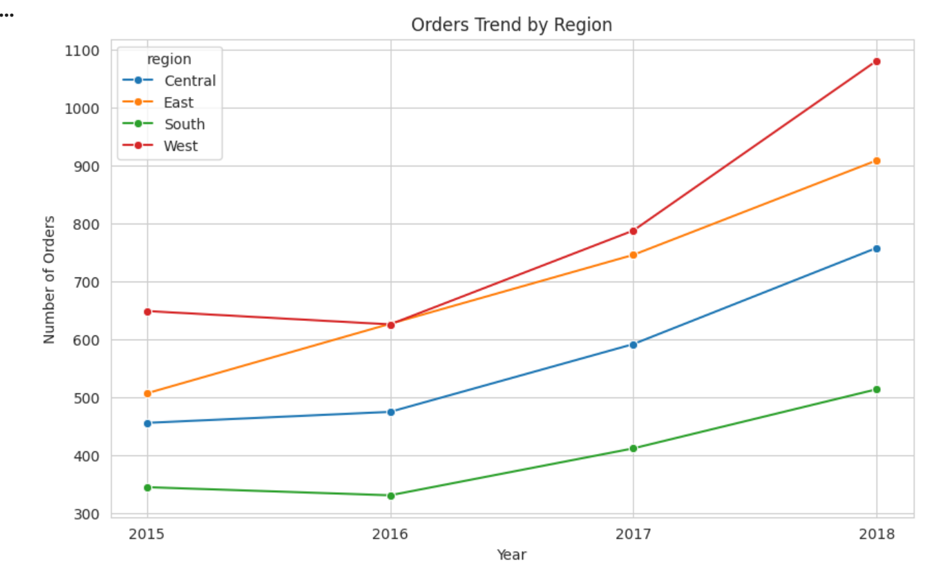
Orders by region analysis
Observation:
order volume declined slightly in the South region.
The reduction in orders was significantly lower than the 33.21% decline in sales.
This indicates that the sales decline was not solely driven by fewer orders.

Slide 10
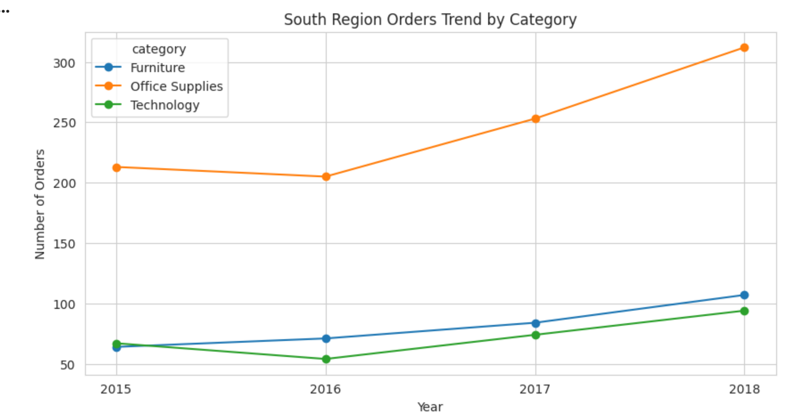
South region order analysis by category
Observation:
Orders in the Technology category decreased over the period.
The decline indicates reduced demand for Technology products compared to previous years.
The reduction in Technology category orders may have impacted overall sales performance.

Slide 11
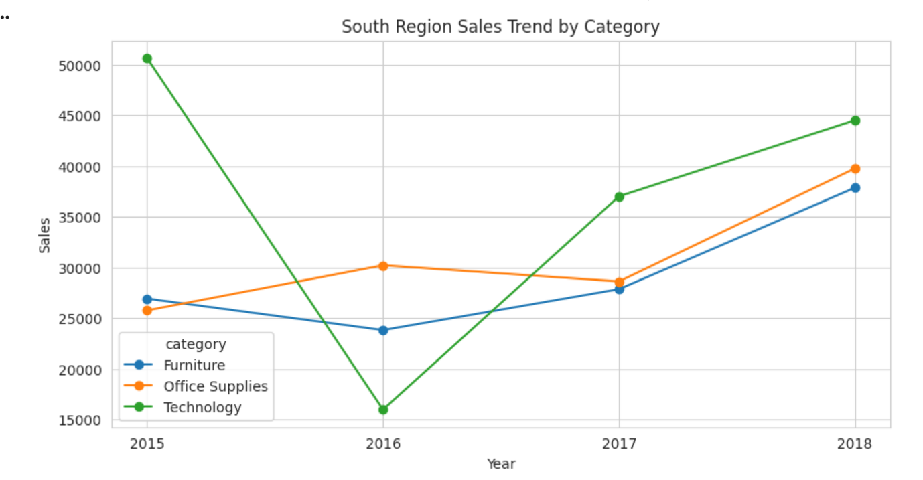
South regional sales analysis by category
Observation:
Sales in the Technology category decreased over the period.
The decline in sales aligns with the reduction in Technology category orders.
Lower sales from Technology products negatively impacted overall business performance.

Slide 12
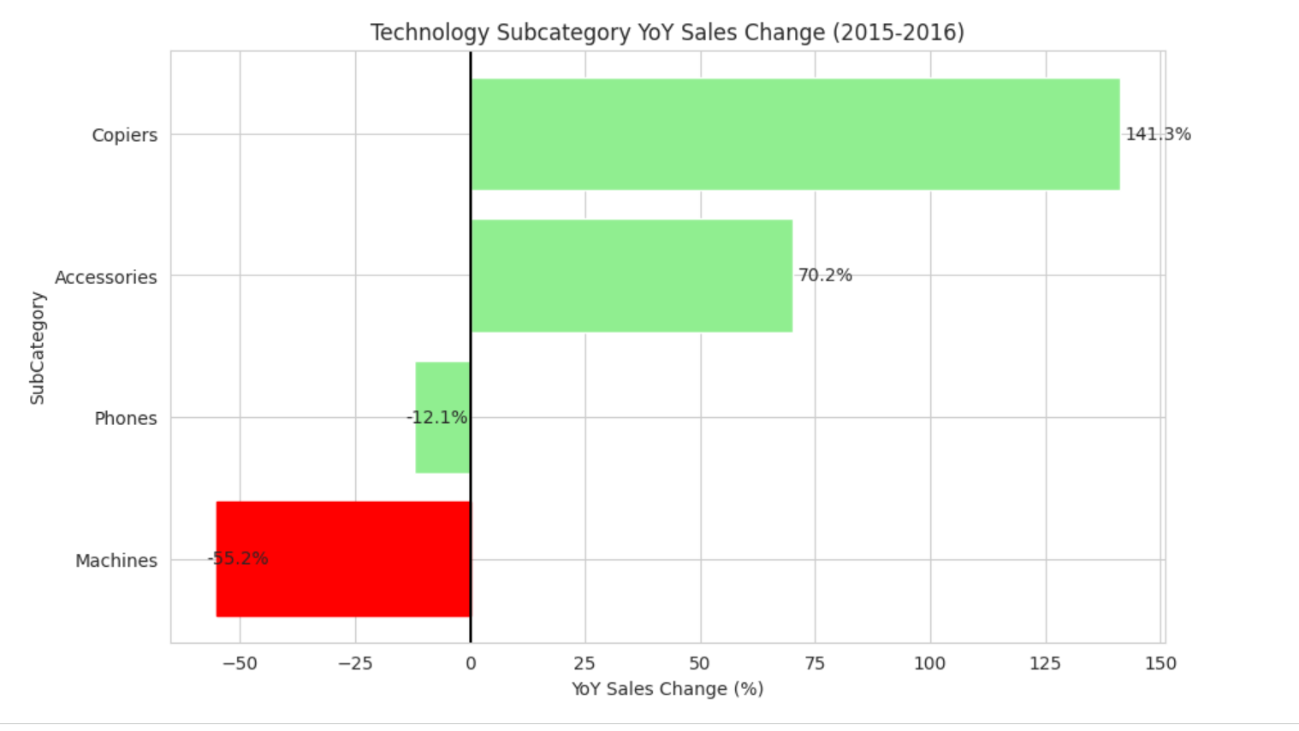
South region sales analysis by sub category
Observation:
Sales in the Machines sub-category decreased by 55.2%.
This was the largest decline within the Technology category.
The sharp reduction in Machines sales was a major contributor to the overall sales decline in the South region.

Slide 13
Conclusion
The analysis identified a significant decline in sales during 2016, primarily driven by the South region.
The 2016 sales downturn was primarily driven by weak performance in the South region, particularly within the Technology category. The sharp decline in Machines sales emerged as the key factor behind the overall decrease in revenue, making it the most critical area for further investigation and business improvement. This decline may be driven by a shift toward lower-value purchases, lower orders in south region impacting overall revenue growth.

Slide 14
Thanks a lot!
Contact
Meghana Suresha meghanamegha0610@gmail.com

